Slide 1
Extraction of Roads from Satellite Images using U-Net
Internship Project Final Presentation

Slide 2
Objective: Develop a model to perform binary segmentation to classify each pixel as 'road' or 'non-road’.
Particularly focusing on areas where roads are narrow or unplanned.
Applications:
Urbanization and Infrastructure Planning: Explain how accurate road maps are crucial for urban planning, infrastructure development, and transportation management.
Autonomous Navigation: Mention the relevance of accurate road detection for autonomous vehicles and navigation systems.

Slide 3
Datasets Used
Wuhan University (WHU) Road Dataset:
Satellites: Gaofen-II, WorldView-II, and ZY-III.
Resolution: 0.5–2 meters per pixel . (0.5-0.8 were used for training)
Annotations: Labelled using ArcGIS software .
Types of Roads: Roads wider than three meters and longer than five meters.
Total Area: Over 1145 km²
Image Tiles: 512x512 pixels, 6828 samples.

Slide 4
Datasets Used
2.DeepGlobe Road Extraction Dataset:
Satellites: DigitalGlobe satellites (including WorldView-2, WorldView-3, and QuickBird)..
Resolution: Varies, typically around 0.3–1 meter per pixel.
Annotations: Labelled using QGIS software .
Types of Roads: Various types of roads, including highways, primary, secondary, and tertiary roads.
Total Area: Over 2200 km²
Image Tiles: 1024x1024 pixels, 6226 samples.

Slide 5
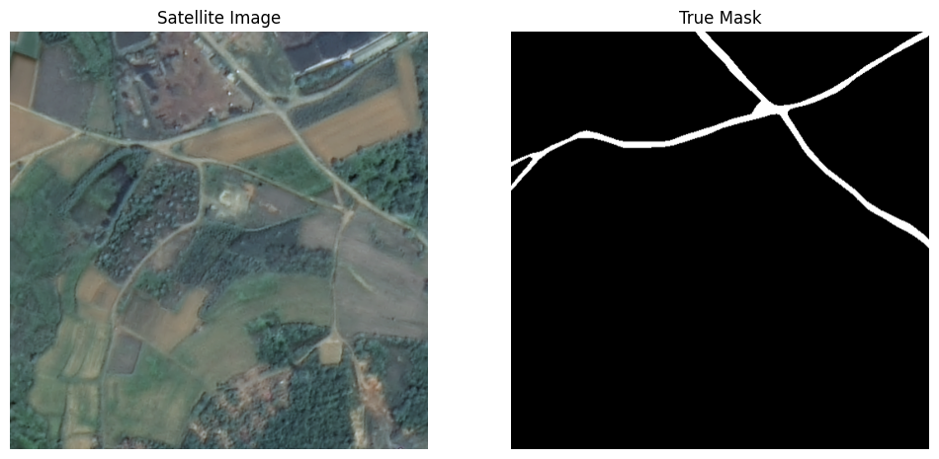
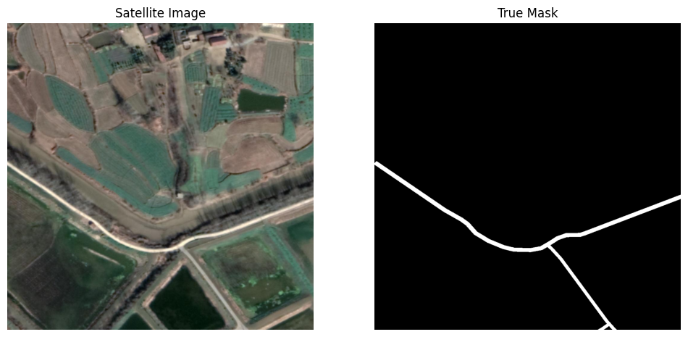
Datasets Used

Slide 6
Methods:
As we were using high resolution images we can do the segmentation in 3 ways .
By dividing the high-resolution images into patches of (512,512) and use the U-net which takes.
Design U-net for which takes (1024,1024) images as input.
By compressing the images to (512,512) and training the model with those images.(Not recommended)
I have worked on all the 3 methods.

Slide 7
Challenges
As roads are like a network cropping the images into patches will make it difficult for the model to learn the feature.
If we use the compressed images,it would be difficult to interpolate after prediction.
Using the U-net model designed for (1024,1024) images requires high computational power even though it gives the best results.

Slide 8
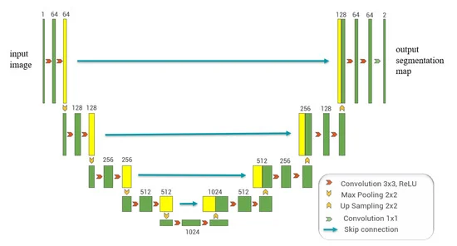
Architecture of the U-net

Slide 9
Enhancements to the Classical U-Net
Batch Normalization:
Added after each convolutional layer
Stabilizes and accelerates training
Dropout:
Introduced in deeper encoder and decoder layers
Reduces overfitting
Kernel Initializer:
Utilized 'he_normal' initializer for all convolutional layers
Improves weight initialization

Slide 10
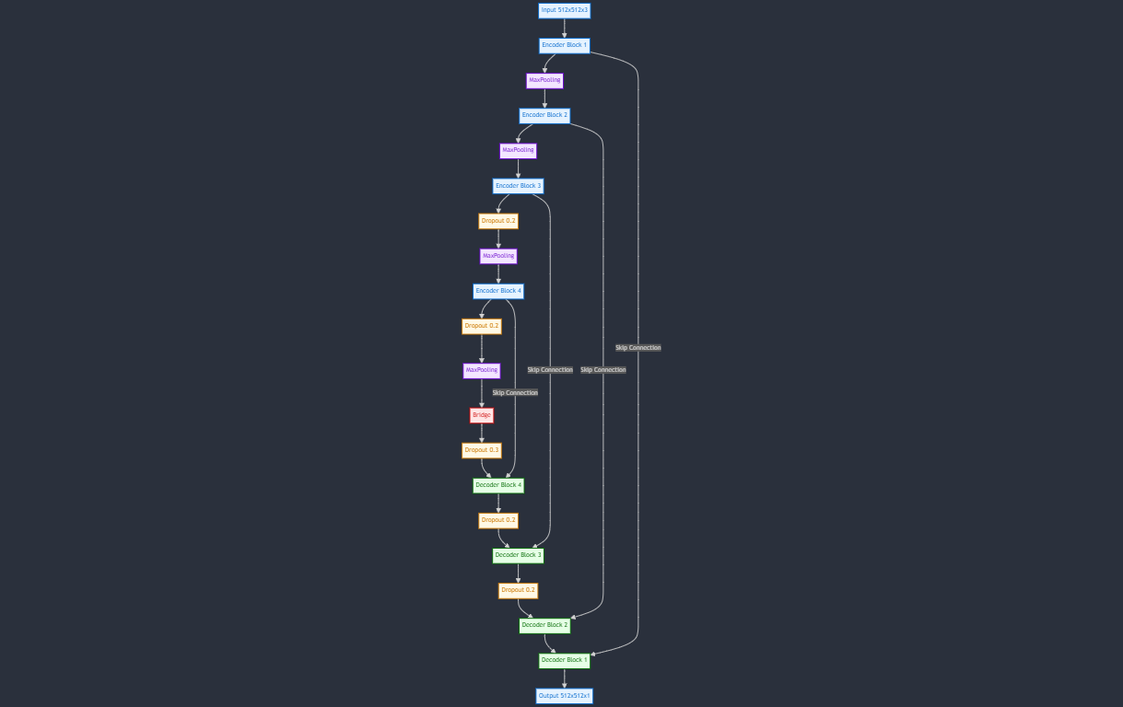

Slide 11
Implementation Steps
Augmentation was added to the training data which includes flipping , rotating , randomizing brightness and contrast.
A Data generator class was created for loading the data in batches.
Jaccard Loss was used which is the negative of the Jaccard coefficient.
Adamw optimizer was used with L2 regularization technique.
Model training techniques like Early stopping and Reduce Learning Rate on Plateau are also used.

Slide 12
Metrics and Evaluation
The metrics that were tracked after each epoch are:
Precision
Recall
F1-Score
IOU (intersection over union)

Slide 13
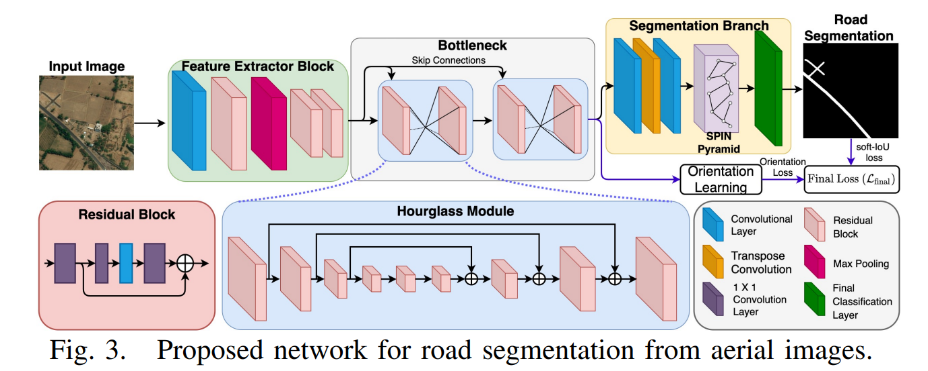
Benchmark
The best IOU on the Deepglobe dataset was 0.67 in a paper named SPIN(Spatial and Interaction Space Graph Reasoning) Road Mapper.
They were using SPIN graph reasoning across multiple scales to extract multi-scale features.

Slide 14
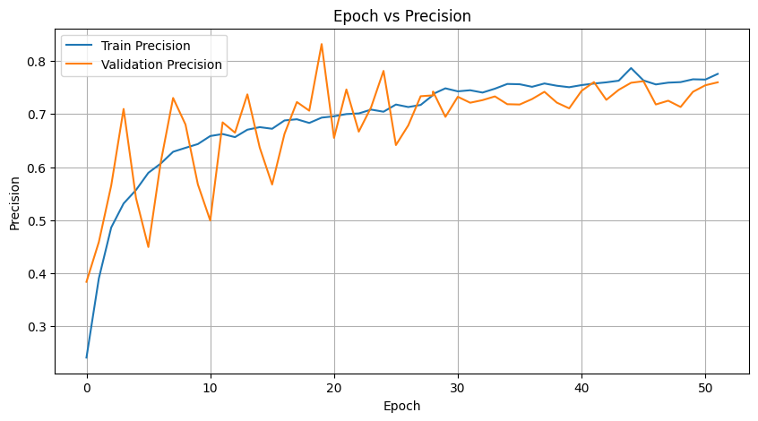
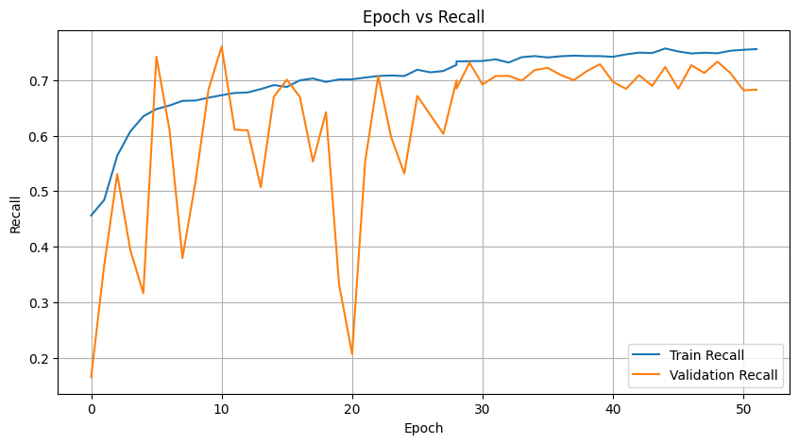
Precision and Recall

Slide 15
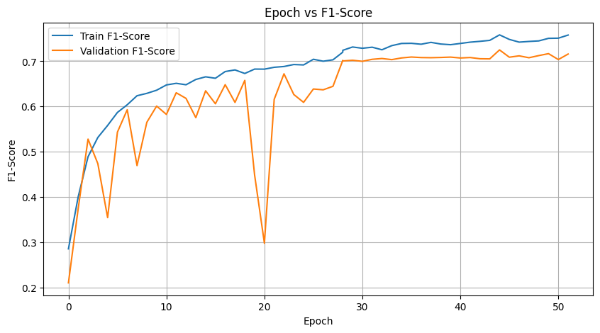
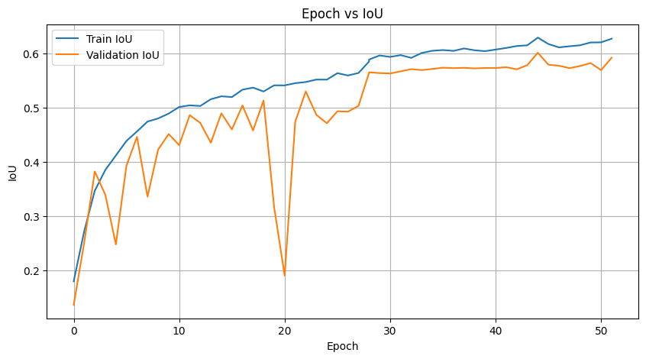
F1-Score and IOU

Slide 16
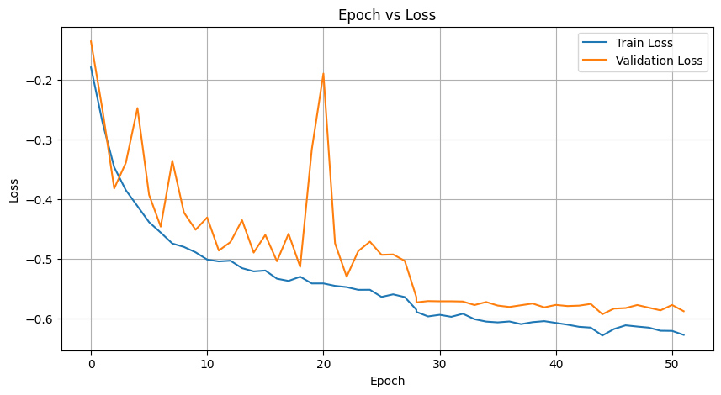
Loss

Slide 17
Results
The best f1-score on the test set is 0.758
The best mean IOU on the test set is 0.601

Slide 18
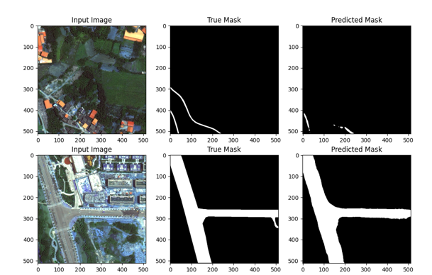
Results

Slide 19
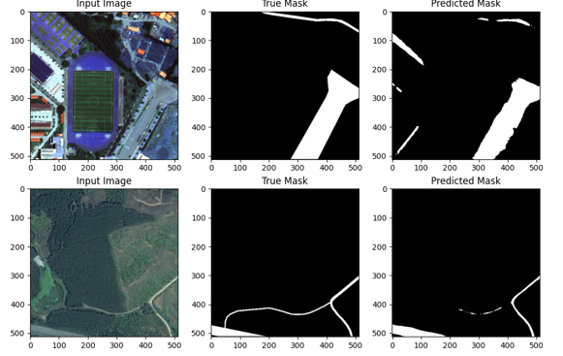
Results

